Slide 1
Arrupe College
Information System: Course Registration
Dr. G. Mardai.
Registrar/Acting Dean

Slide 2
General Outline
Items I need before I register my courses
ACIS – Website
Login – using assigned Username and Password
Fill Out Personal Data
Search for Courses and then Register
Delete Course – if necessary
Logout
Forgot Password Procedure

Slide 3

Academic Program: Find the Page for your Course List

Slide 4
Items I need before I register my courses
A stable internet connection – preferably WIFI
College Website: www.acis.arrupecollege.org
Username:
Password:
College Academic Program for the Academic Year (2017-2018)
(Course list for your degree program)

Slide 5
Login – using assigned Username and Password
Every student in Arrupe has an assigned Login name and Password from the ICT Department
It is usually derived from your lastname and your Arrupe College Registration number.
E.G. Username: amadir2017
Password:********
(This is not a real student username)
You should receive yours from the ICT Department.

Slide 6
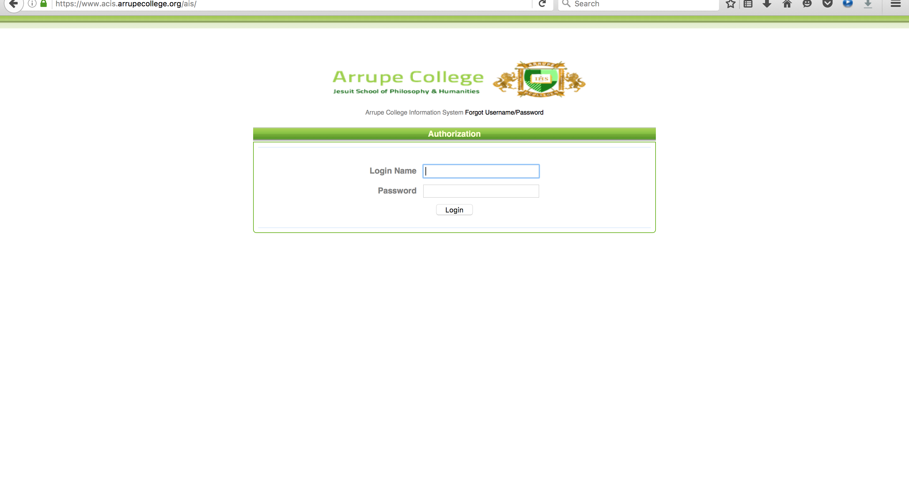
Personal Password)
(Once you Login – Change Your Password. There is a fee for forgetting your password

Slide 7
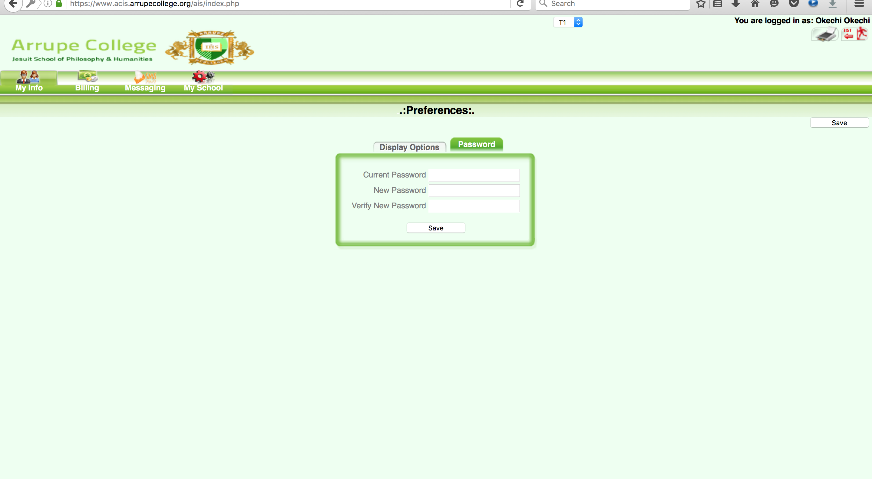
Change Password – after Login

Slide 8
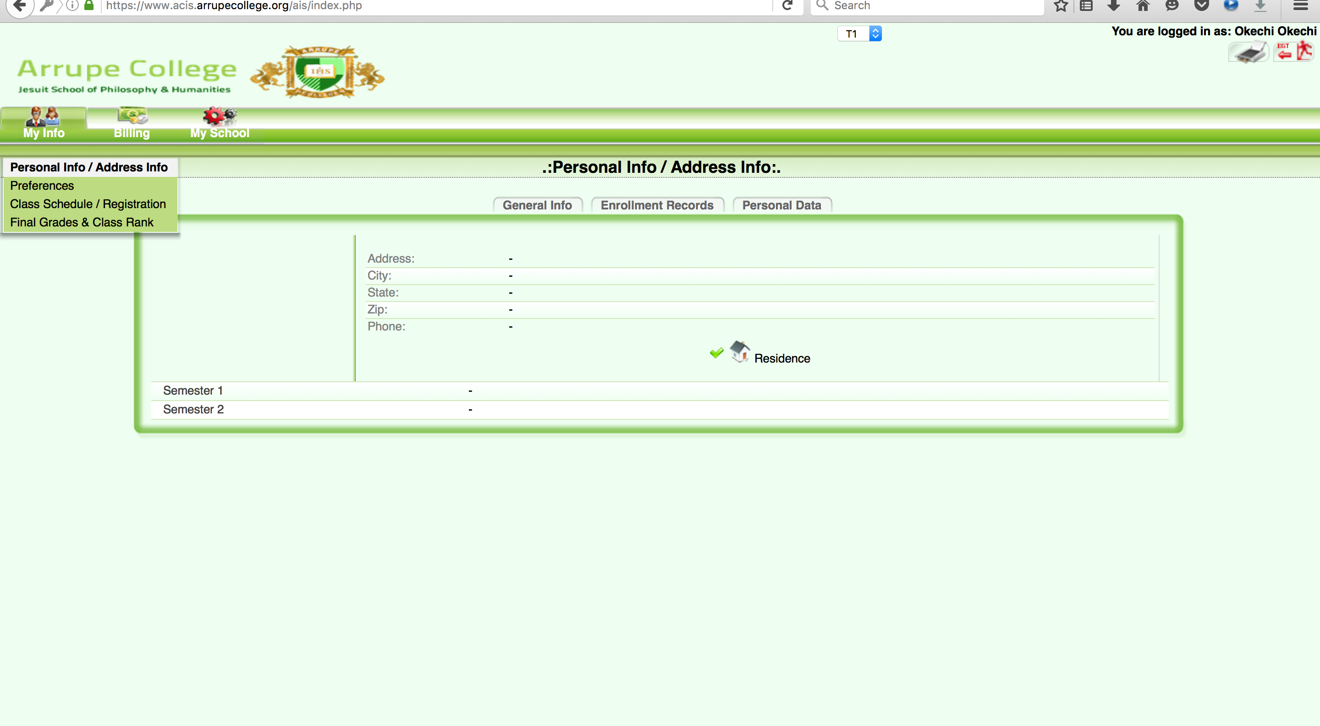
Click on My Info

Slide 9
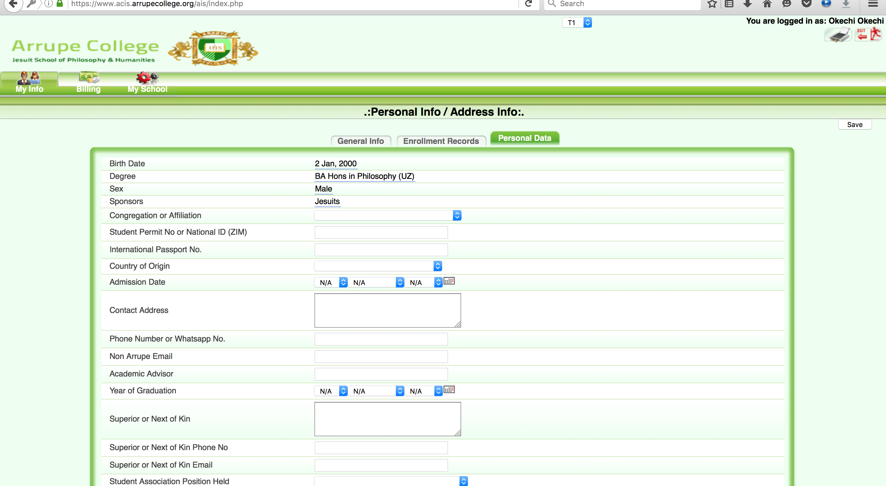
Personal Data
(Fill in Your Personal Data – Click on My Info, then Personal Info, then Personal Data)

Slide 10
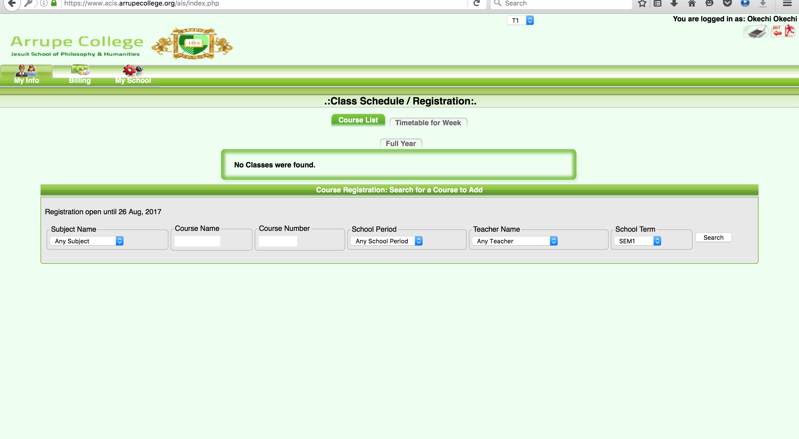
Search for Courses and Register – Click on My Info, then Class Schedule/Registration

Slide 11
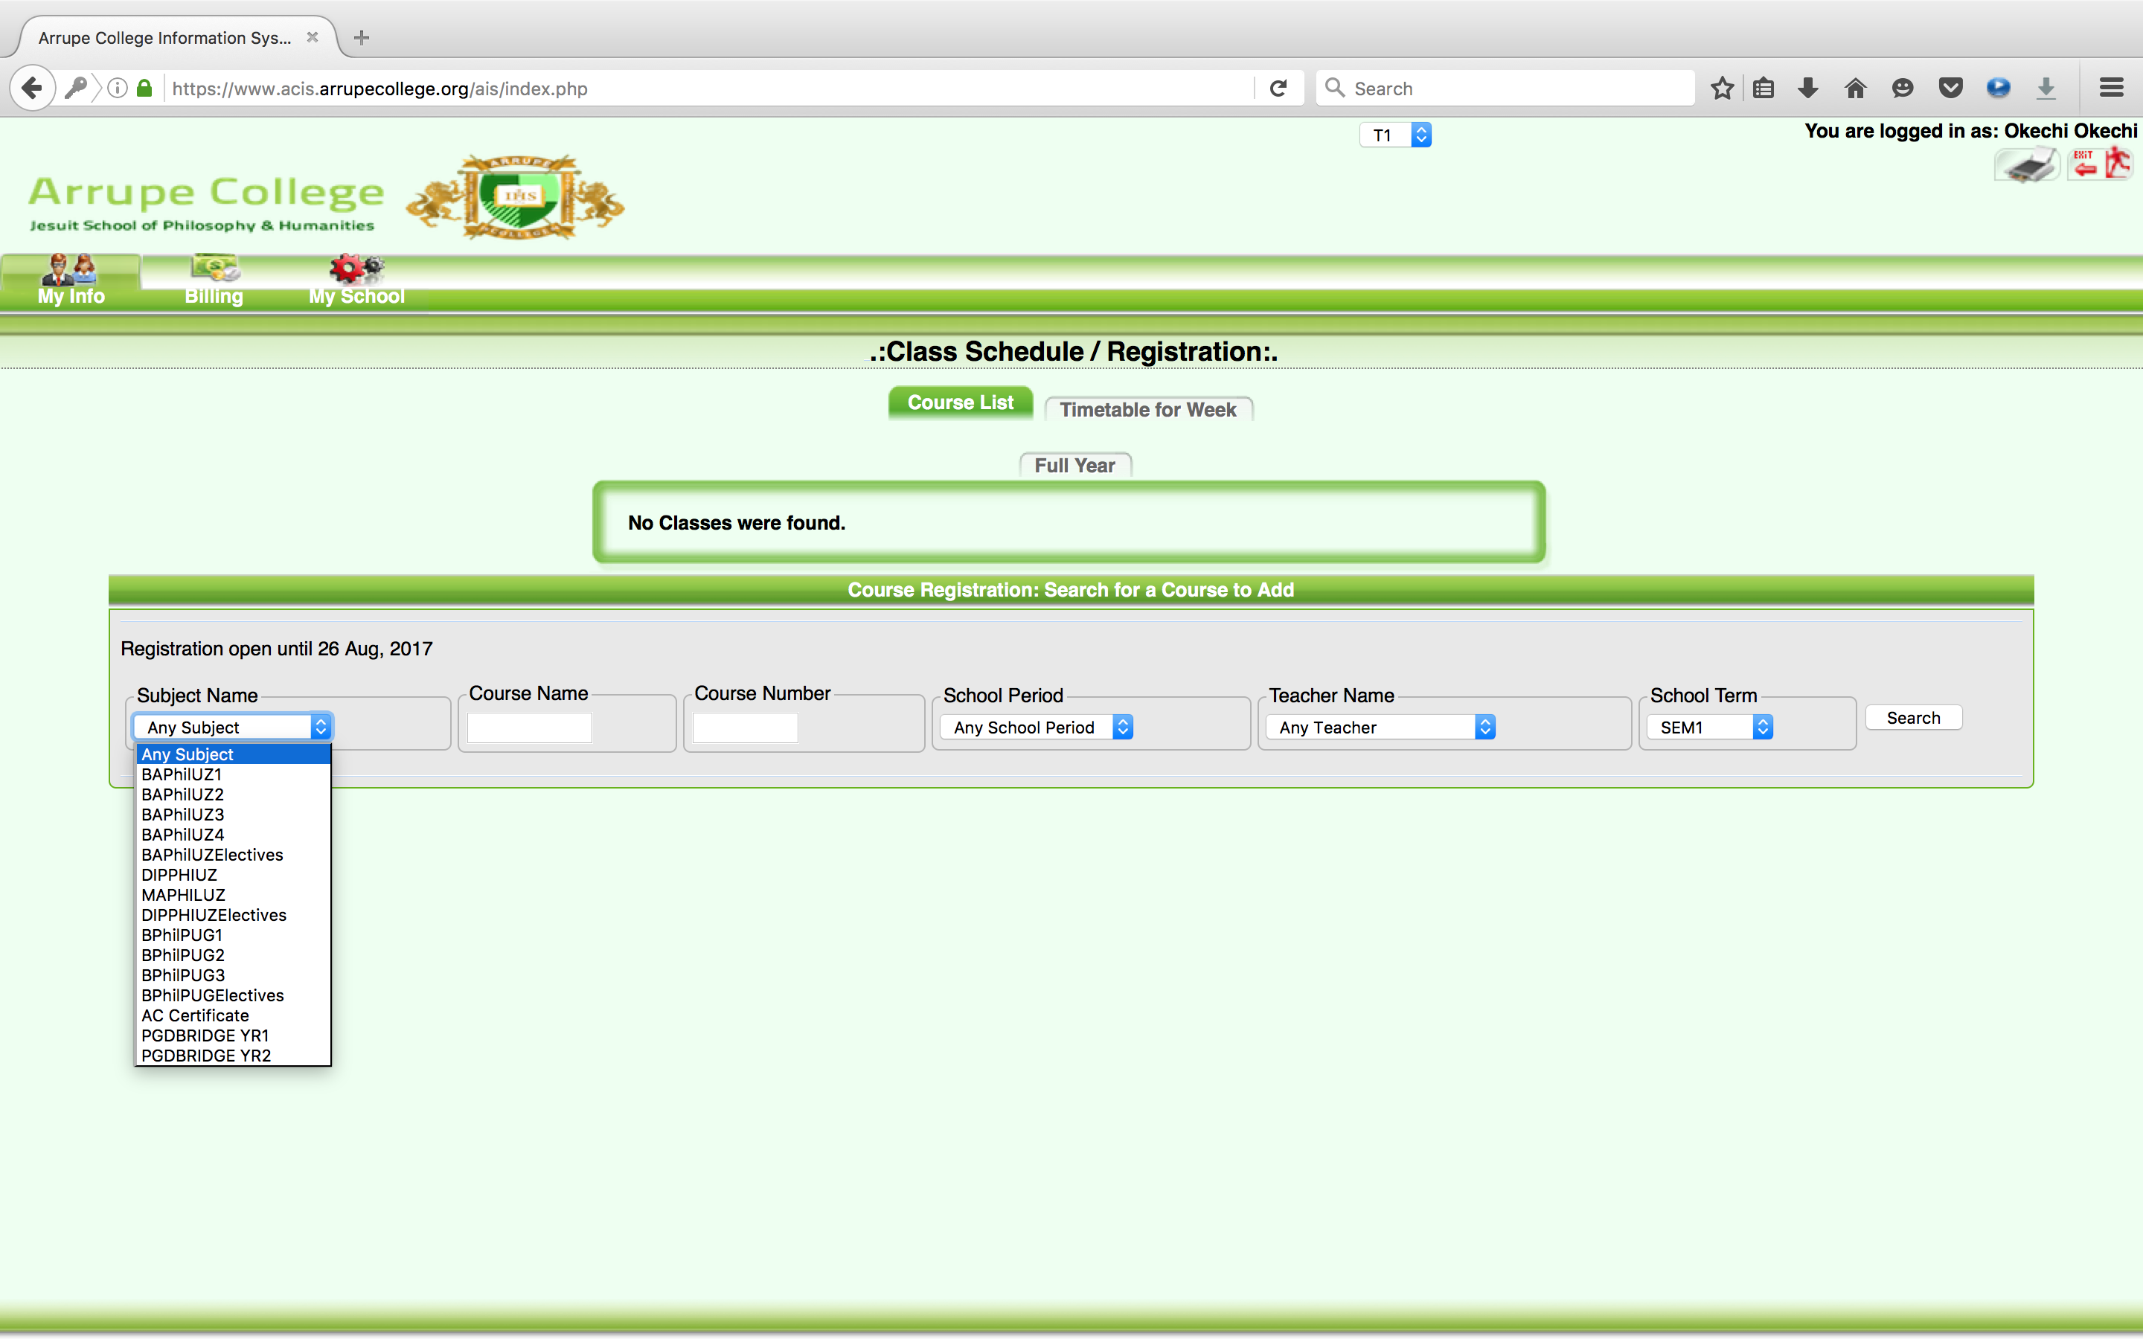
Click on Subject Name – Select your Class level E.G.BAPHILUZ1 means BA Degree – UZ year 1. (Do not change anything else)

Slide 12
Class Levels - Explained
BAPHILUZ1 (1,2,3,4) – BA in Philosophy, University of Zimbabwe – Year 1.
BAPHILPUG1 (1,2,3) – BA in Philosophy, Gregorian Degree Year 1.
PGDBRIDGEYR1 (1,2) – PGD – Post Graduate Diploma in Philosophy Year 1.
MAPHILUZ – Masters in Philosophy – University of Zimbabwe
BAPHILUZELECTIVES – For only eligible BA UZ students
BAPHILPUGELECTIVES- For only eligible BA PUG students
(Any course that is incorrectly chosen will be deleted and the marks will not be recorded. Choose only Courses for your class level)

Slide 13
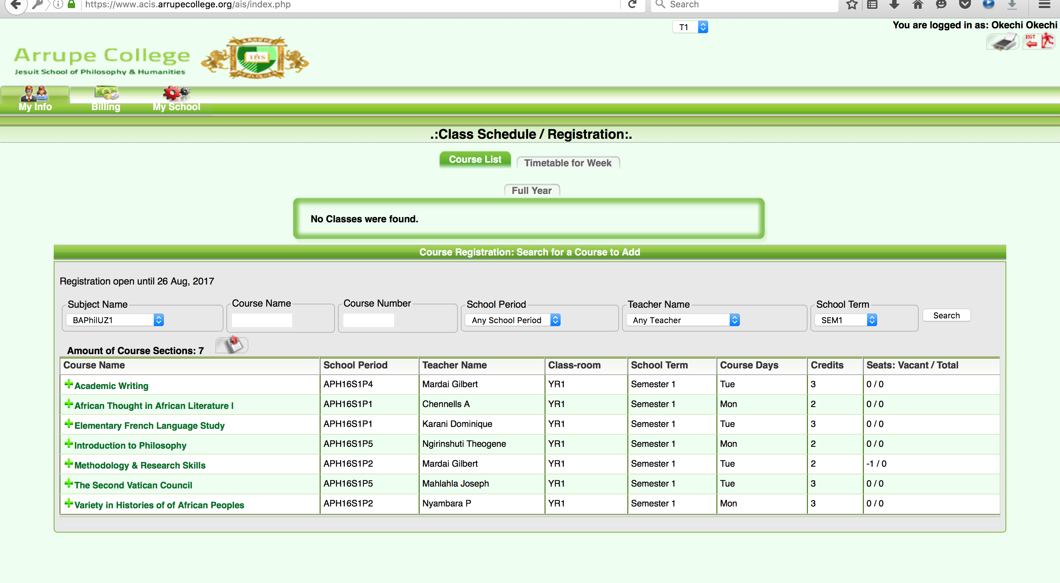
Click on the Green Plus Sign + to add a course

Slide 14
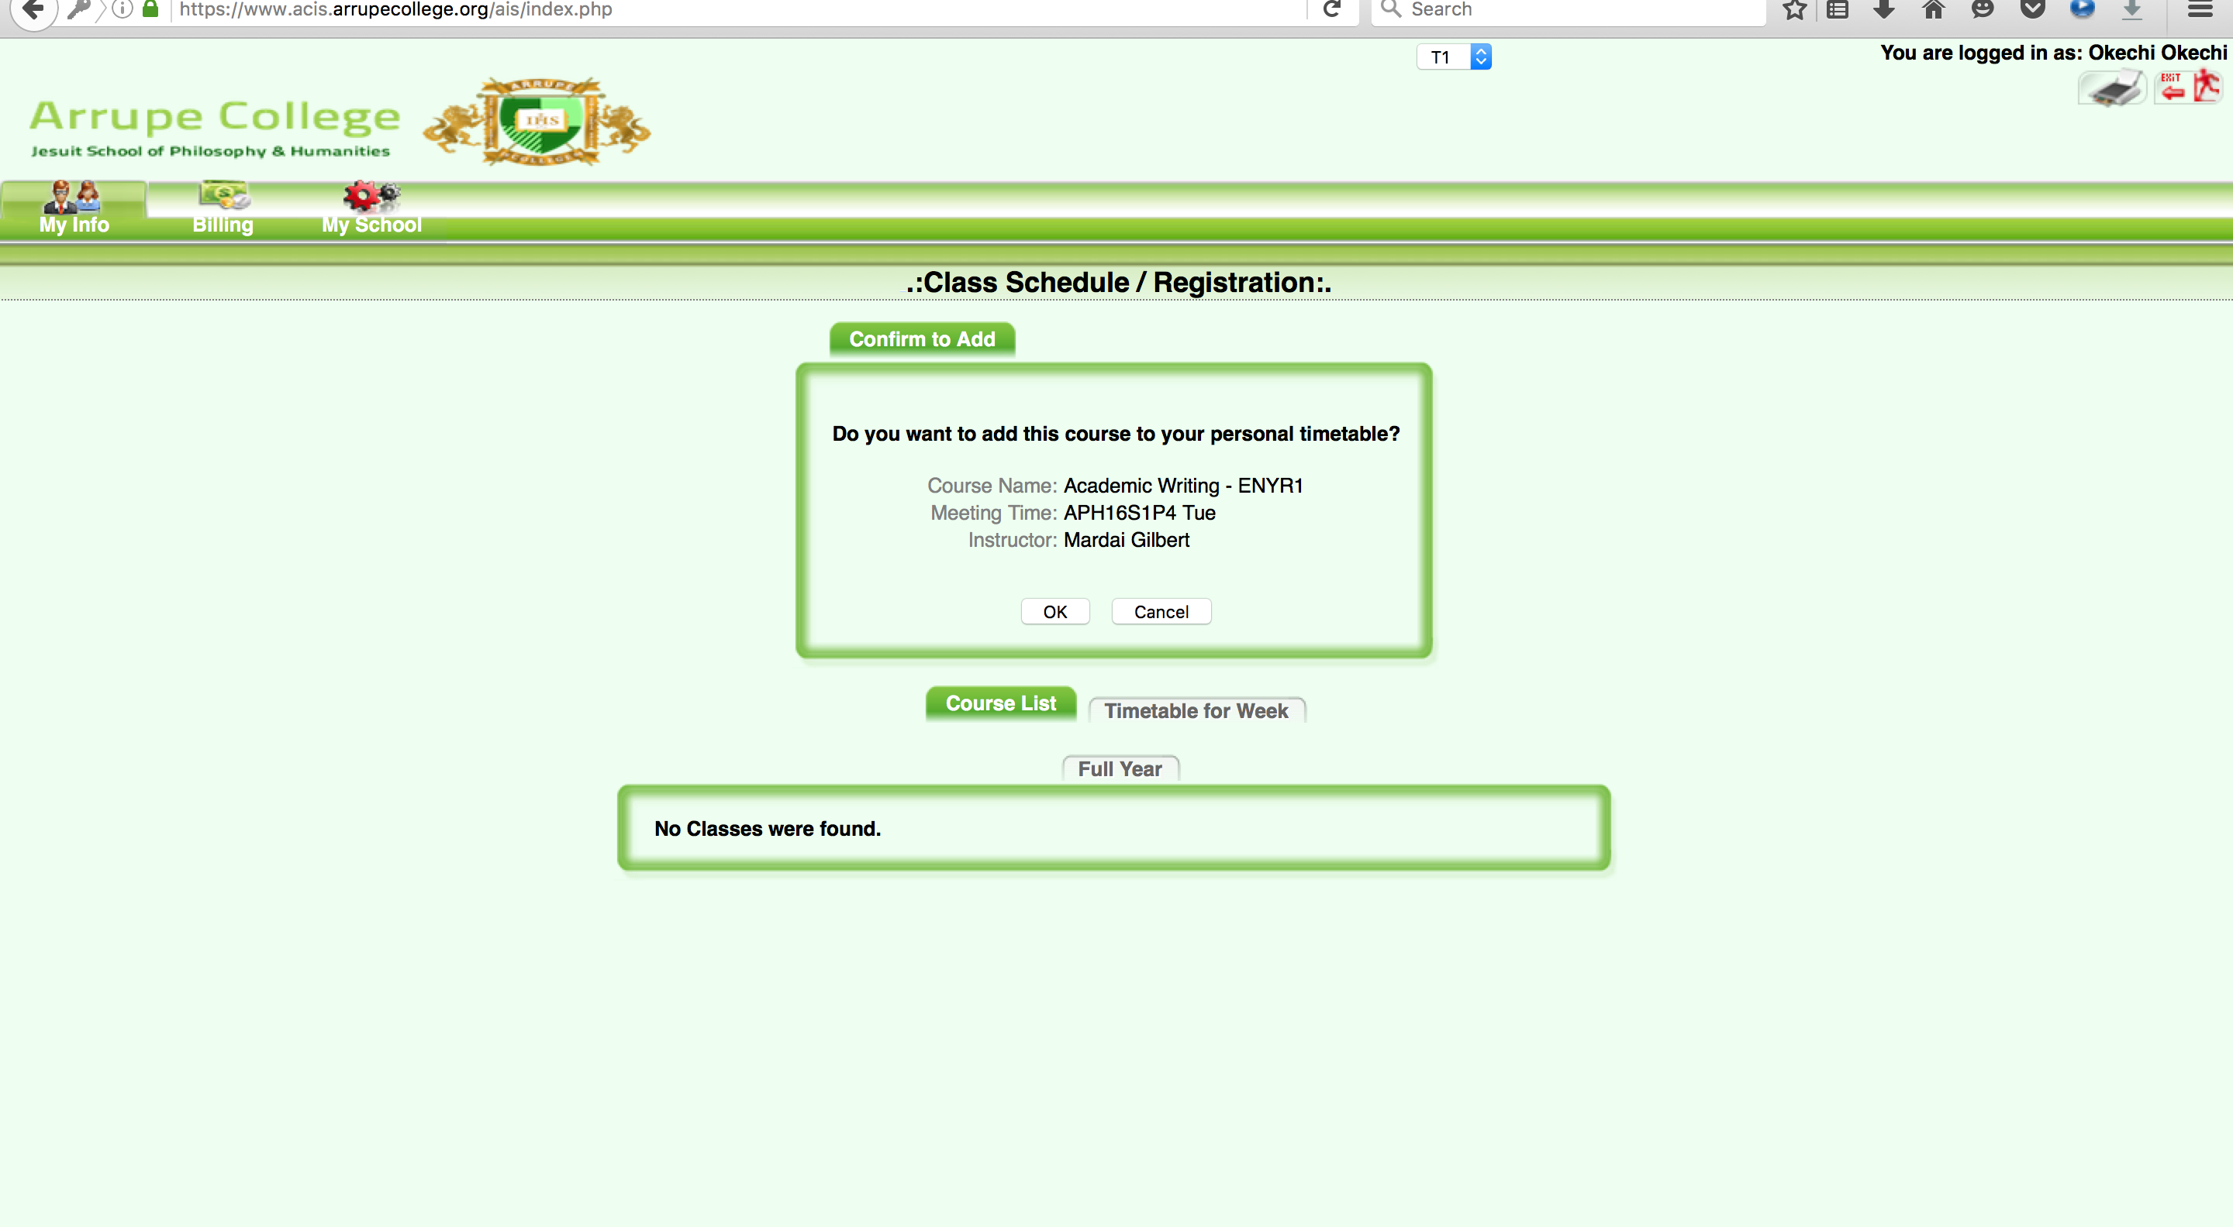
Click OK to Accept or Cancel.

Slide 15
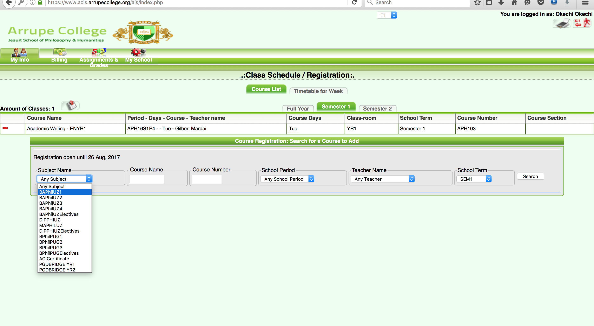
Add other courses the same way

Slide 16
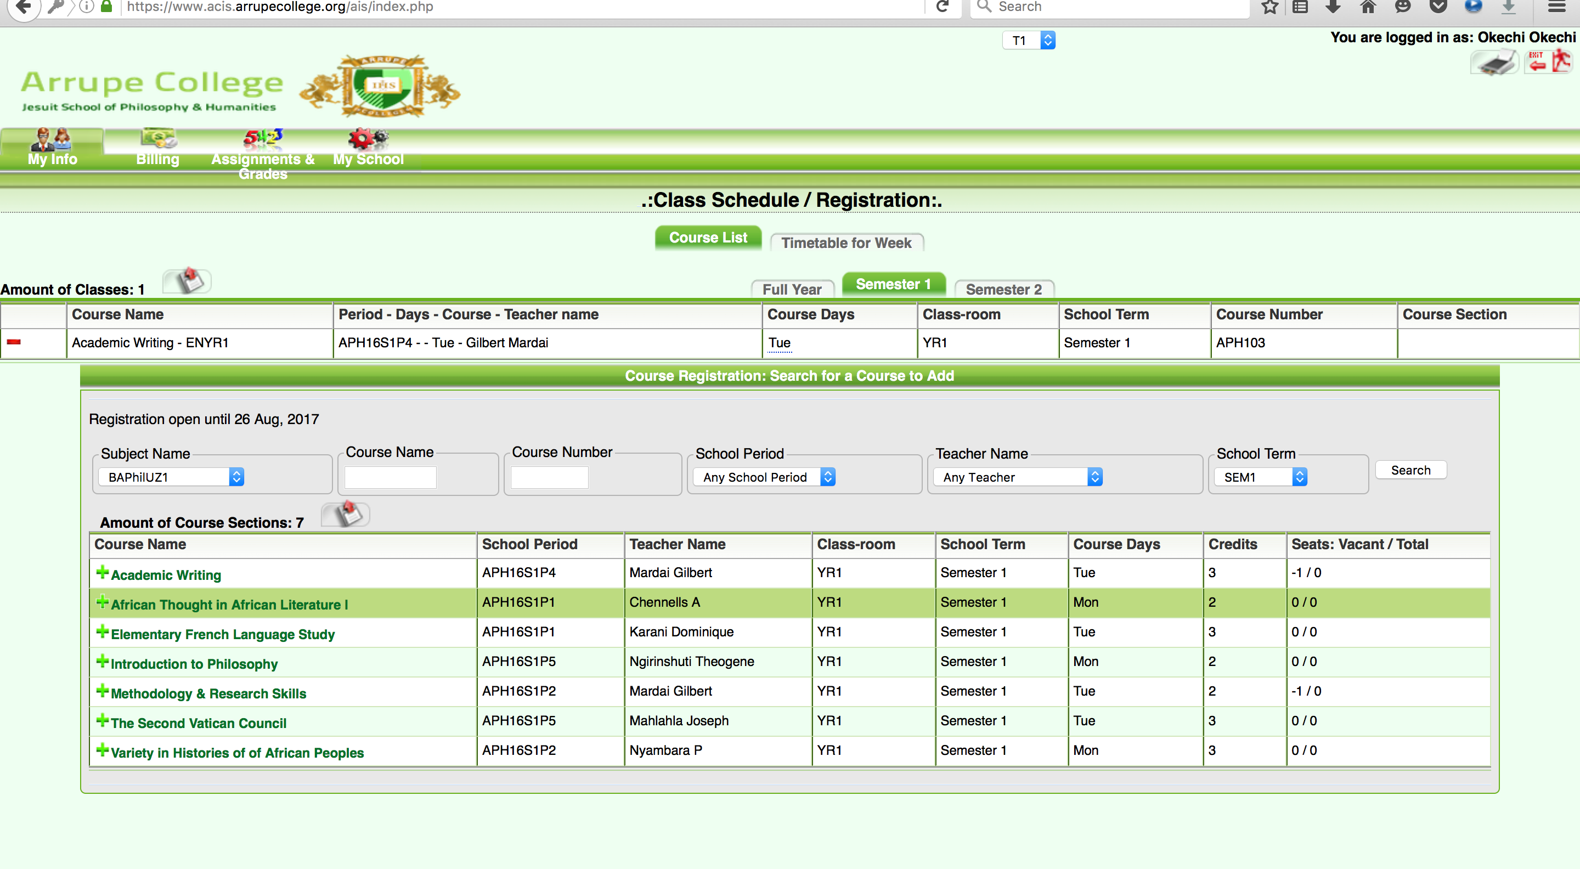
Delete Course – if necessary (Click on the Red Dash Sign – on the Left side

Slide 17
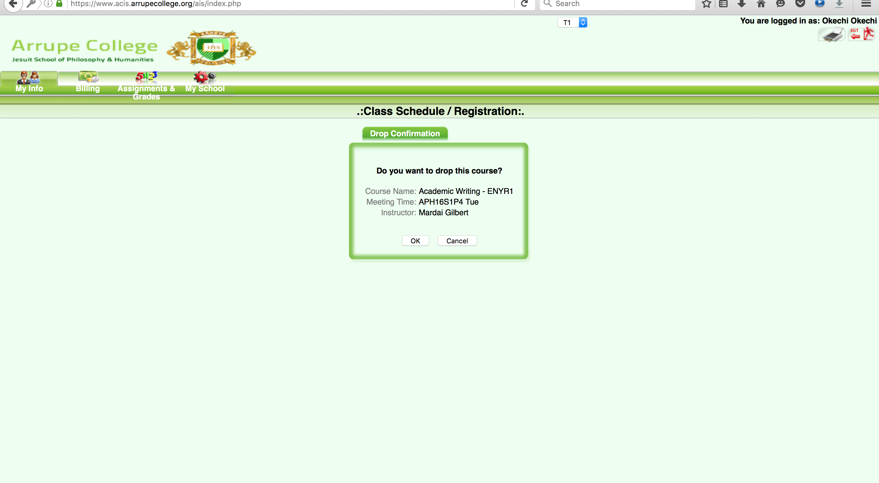
Click Ok to Accept or Cancel

Slide 18
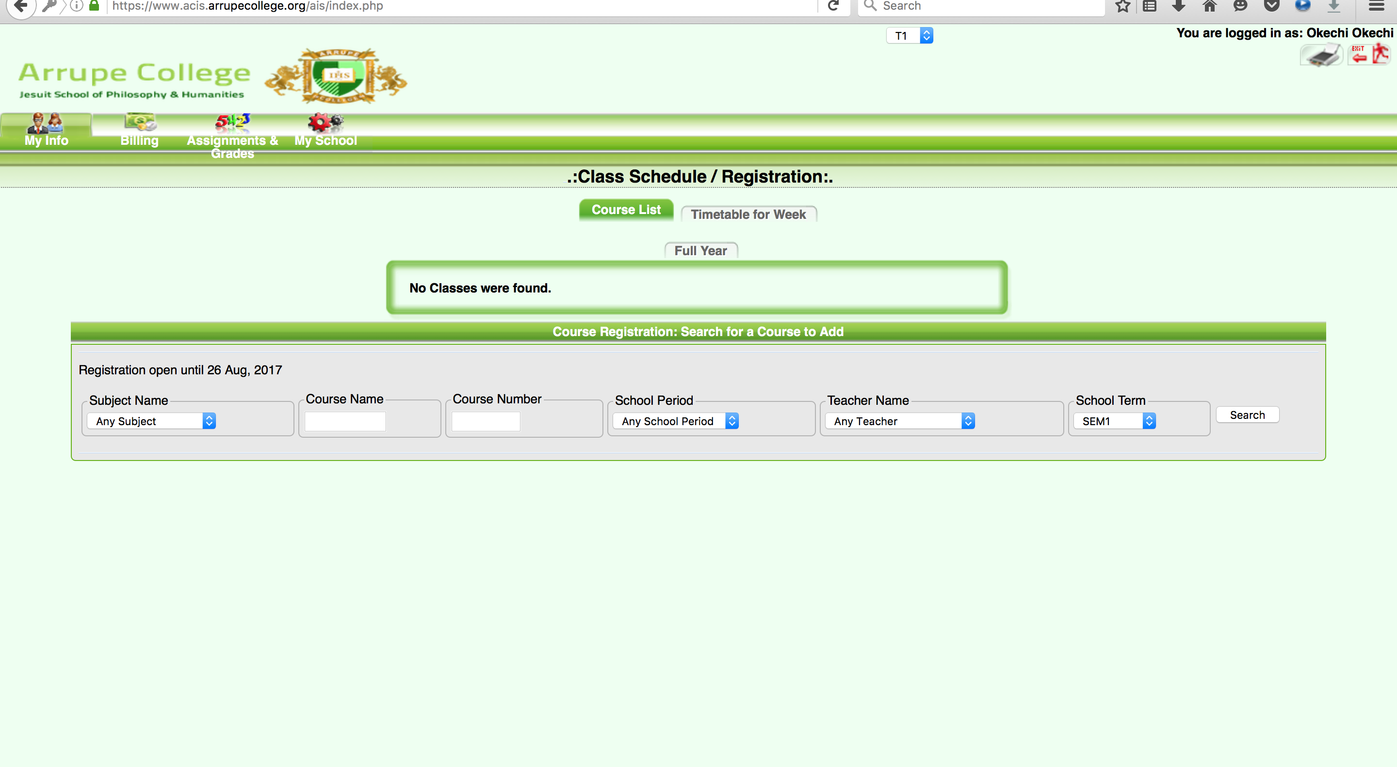
Logout – Click on the Top Right

Slide 19
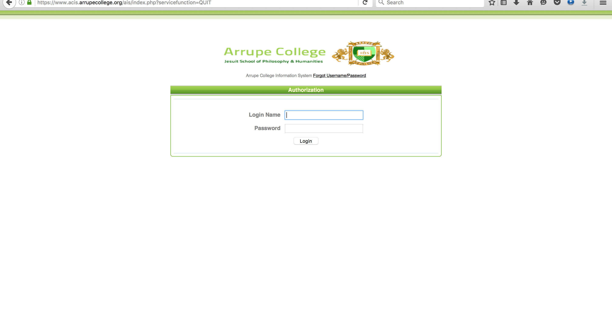
Forgot Password Procedure – on the Website Click on Forgot Username/Password

Slide 20
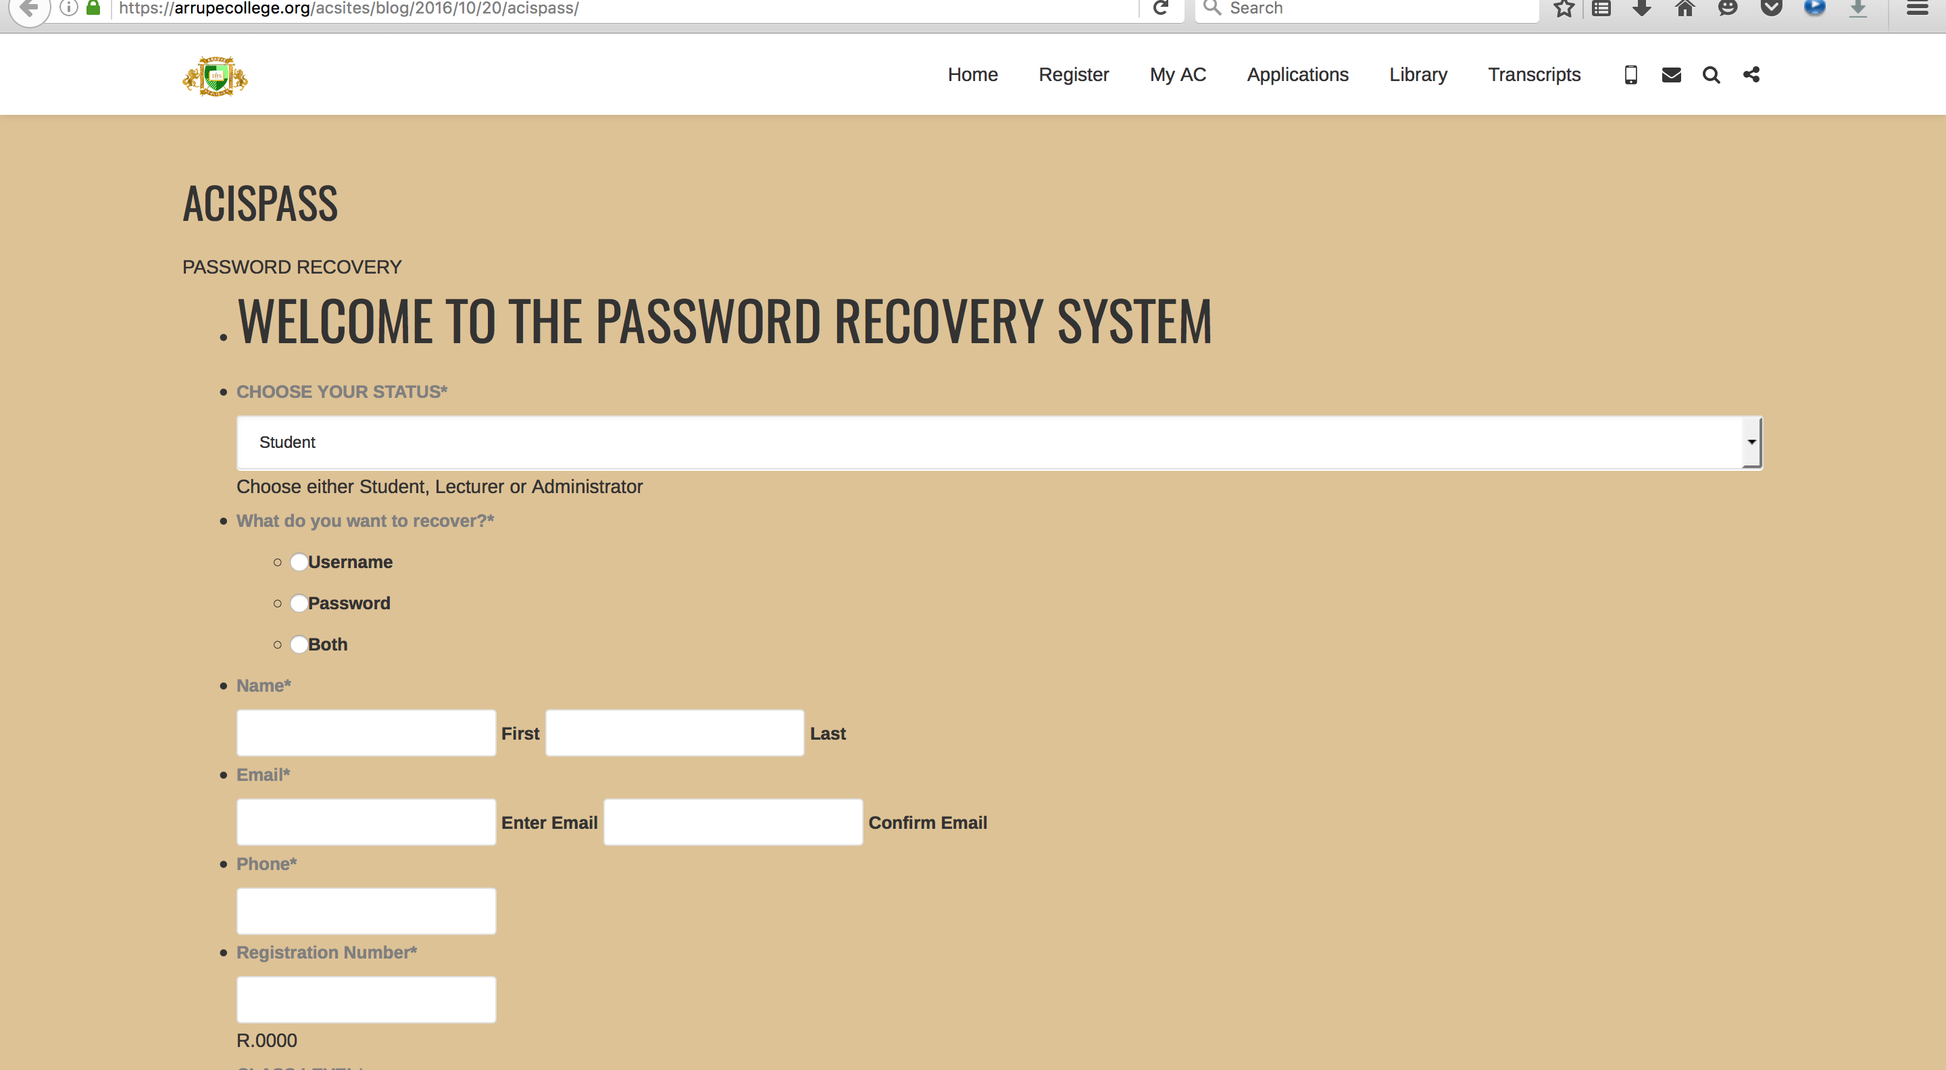
Fill Out the Recovery Form and Submit.

Slide 21
Keep Safe & Secure Your
Username and Passwords
Privacy and Security – to be observed by all students
Keep your Username & Password safe.
Do not share them with anyone.
Do not forget them – You can save them on your personal computer browser.
A Fee of $3 may be charged for any student who forgets his/her password more than once.
Our Passwords are Encrypted with 256 Bit. A good reason to keep them safe –
(the ICT Department has to recover them every time you forget them).

Slide 22
Notice – Dates
Last Date for Course Registration: August 4th
Last Date to Add/drop Courses: August 18th
For more clarifications send an email to dean@arrupe.ac.zw

Slide 23
Thank You.
Questions???

